Slide 1
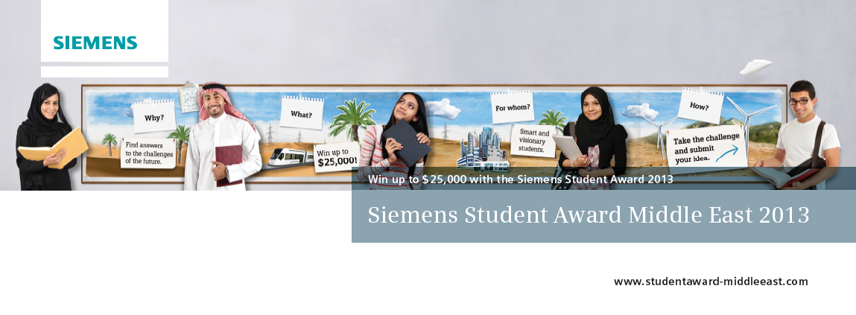
Siemens Student Award 2013
Siemens ME. All rights reserved.

Slide 2
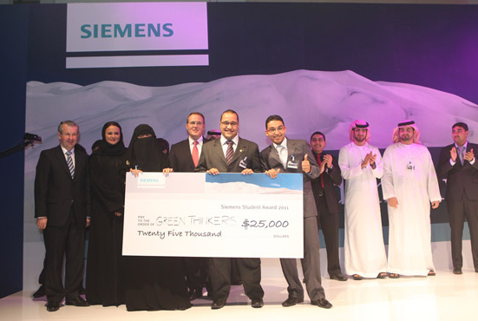
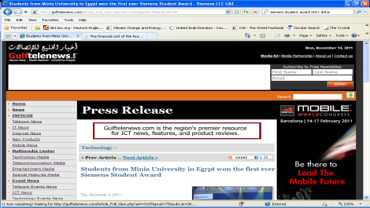
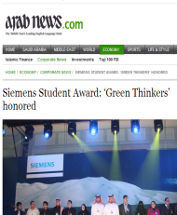
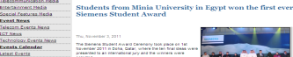
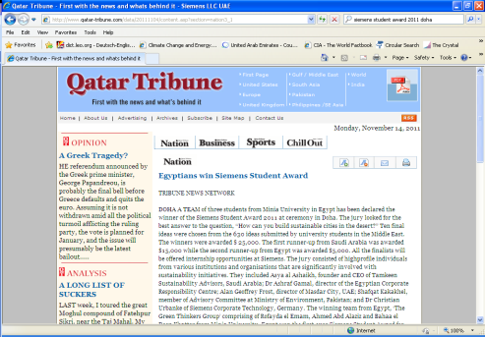
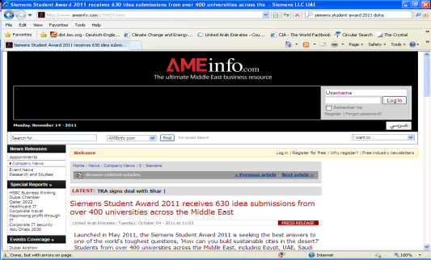
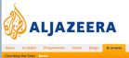
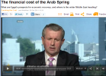
Summary: Siemens Student Award 2011
630 ideas from university student in the ME
32% Females
8,500 online registered community members
23,000 unique visitors worldwide
The finalists were from universities in Pakistan, UAE, Qatar, KSA and Egypt and all were invited to the award event
The jury consisted of 5 high-profile individuals involved with sustainability initiatives around the Middle East
The award ceremony was held on 1st November 2011 in Doha, Qatar, where around 200 guests attended
Winner (US$ 25,000): “The Green Thinkers Group” with the idea of a Spiral Power Plant (Minia University, Egypt)
2nd Prize (US$ 15,000): “Transferring A Desert Into A Haven“ with the idea of an integrated all-round system (KAUST, KSA)
3rd prize (US$ 5,000): “Effective Desalination System” (Suez Canal University, Egypt)
Facts & Figures
Total clips: 227
3 Languages: Arabic, English and Urdu
Media used: Print, Online, Radio and TV
Content: Press releases, editorials and personal interviews
Media Relations Facts & Figures

Slide 3
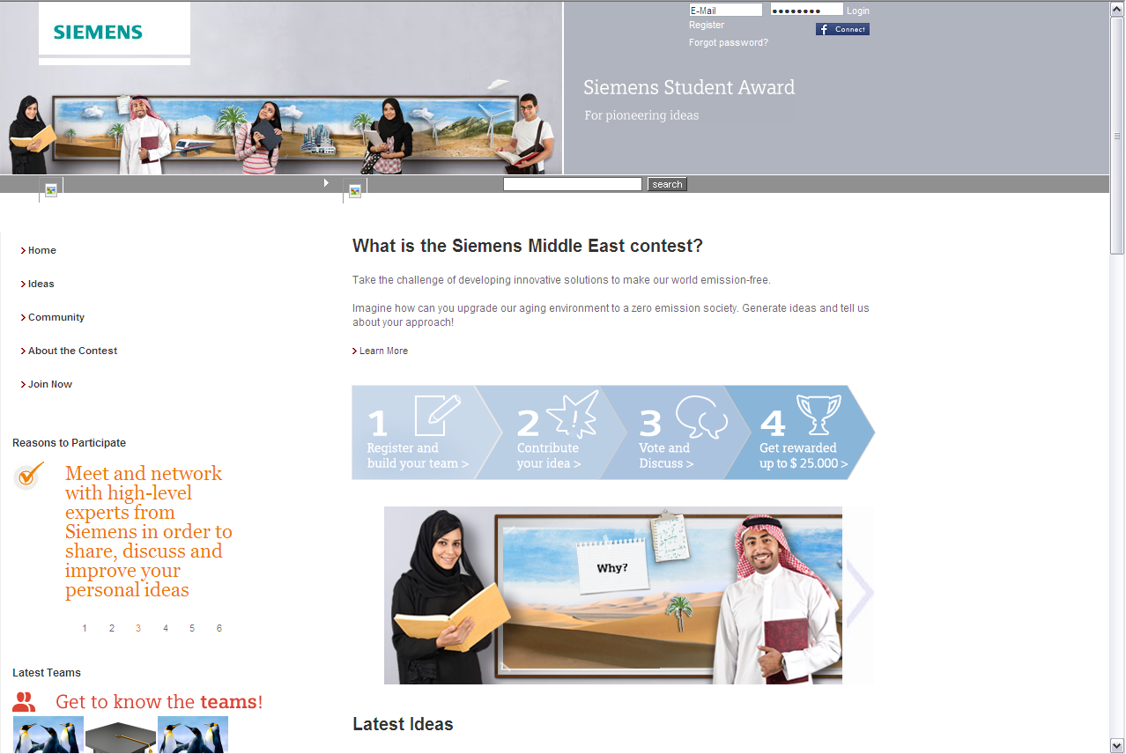
Siemens Student Award 2013
Internet Platform

Slide 4


Siemens Student Award 2013
Competition Rules and Mechanics
Any student at a college or university in the
Middle East can participate
  Students upload submissions to an online platform
www.studentaward-middleeast.com
  Only groups up to 3 persons
  4 challenges
  Groups can choose 1 up to 4 challenges
Evaluation:
  Siemens Student Award expert committee (10 per challenge)
  Siemens Competition Committee
  The Jury: 5 high-profile individuals involved with innovation
  and sustainability initiatives around the Middle East
  People’s choice: Most “likes” on the online platform
4
Finalists
Prizes
  1 Overall winner: USD 25,000
  3 Category winners: USD 10,000 (each)
  People’s choice: USD 1,500
  Total prize money: USD 56,500
1
1
Winner
Notes:
4

Slide 5
Siemens Student Award 2013
Competition Evaluation Mode
All Submissions
Student Award
Expert Committee
20 Groups shortlisted
(5 per challenge)
Student Award
Expert Committee
4 Groups as finalists
(1 per challenge)
The Jury
People’s
Choice
Winning
Group
Notes:
5

Slide 6
Siemens Student Award 2013
Timeline
2013
Jan
Feb
Mar
Apr
May
Jun
Jul
Aug
Sep
Nov
Dec
Activities
Launch
@
WFES
University Days
Official kickoff on 24 Feb.
Open for registration and submissions
24 Feb. to 15 May
Experts Evaluation
Stage 1
Semi Finalists
18 Jun.
Submission
Cutoff
Stage 2
Finalists
Agreed
10 Aug.
Jury
Selection
Award Ceremony in Qatar
Nov. 2013
Media Relations
Digital Communication
Notes:
1st Generation: The old companies giving out charities such as Rockfeller.
2nd Generation: When companies react to crisis such as Nike’s reaction to child labor allegations.
3rd Generation: Companies started to become proactive. BP changed it’s tagline to “beyond petroleum” taking on the holistic CSR approach.
Currently: The new era of CSR spreading globally.

Slide 7
Siemens Student Award 2013
Challenge 1: Self sustained sensors system
Introduction:
Sensor networks are frequently used and deployed in today's real-life applications (Machines and processes, buildings, vehicles, personal appliances etc). However, high energy consumption continues to remain a barrier in many sensor network applications. In fact the majority of current sensing systems are wired or use power-limited battery due to their constant need for energy supply and limited energy storage. This implies high work load and cost for the installation. Furthermore, sensors may also be subjected to harsh environment (ambient or otherwise) that rule out a dependable energy supply
The challenge:
Energy harvesting and energy management are two key technologies that enable a self-sustainable wireless sensor network. Your task is to develop self sustained sensors system that can:
• Be powered by the energy they harvest from the environment
•Exchange their information wireless and through mobile devices like Smart Phones, Tablets etc.
•Minimum installation effort since they are self-configuring
•Store / transport information using cloud technology.

Slide 8
Siemens Student Award 2013
Challenge 2: Biomimicry, nature inspiring technology
Introduction:
Water resources are scarce in many parts of the world including the Middle East. A lack of potable water causes acute health and sanitation problems which can turn into a crisis in the event of a famine, war and other calamities. Nature addresses water scarcity with some ingenious designs. One of its best examples is the Namib Desert Beetle. The beetle‟s back surface, made of hydrophilic and hydrophobic materials, has exceptional ability in harvesting water from early-morning moisture-filled air. By positioning itself to take advantage of prevailing wind direction, the beetle maximizes water condensation and channels moisture from its back to its mouth to quench thirst.
The challenge:
Study and examine the Namib Desert Beetle’s design and processes for harvesting water and propose a solution which will:
• Harvests and stores water in a hot and arid environment
• Please note the all energy used in your proposed project should come from renewable sources.

Slide 9
Siemens Student Award 2013
Challenge 3: Imaging and therapy rooms of future
Introduction:
With few exceptions, the majority of interventional rooms in hospitals are divided into either imaging or operating rooms. This results in patients having to endure a two-step process where they undergo surgical and imaging procedures separately and in most cases, in separate locations. Technological advancements are opening new ways of treating patients To make the interventional therapy rooms of the future more efficient while maximizing time and cost, you will come up with a solution that integrates sophisticated imaging technologies with advanced surgical and life-support equipment. Your proposed solution should keep in mind optimal design and location while ensuring maximum patient comfort.
The Challenge:
Developing a multi-functional interventional therapy (eg. surgery) room which includes imaging capabilities to treat patients in the most time and cost efficient manner. Bear in mind patient comfort is of utmost importance as well, Prepare innovative proposals on how imaging and therapy rooms of future would look like
• List and explain the roles of respective technologies and stakeholders
• Comment on interdisciplinary technological and medical collaboration
• Comment on hospital equipment and medical technology, healthcare IT and hospital management systems.

Slide 10
Siemens Student Award 2013
Challenge 4: Next generation of grid control - a cellular structure
Introduction:
Current legacy electrical grid carries energy from a centrally located, often remote, power plant to consumers via transmission and distribution (T&D) lines. Distribution of power from a central plan is increasingly becoming costly because long distribution lines are required to carry power, and less reliable and safer because a single failure in any node within the T&D can impact large number of consumers. The new approach is to generate electrical power from a multiple distributed sources that are located closer to consumers. The idea for such distributed grid„s T&D is to create a cellular infrastructure for carrying electrical energy. In this idea, the consumers and distributed energy sources interact with the cellular T&D concurrently at any given time.
Overall, this cellular distributed power grid can operate independently but therefore, requires sophisticated control strategies to balance generation and load on the lowest possible level, i.e. in the residential area and to manage only the residual load on the next level. Generation within the cellular structure can be considered only from renewable resources. Evaluation of storage capabilities and technologies becomes a key topic of cellular structure.
The Challenge:
Develop a control strategy to balance generation and load on the lowest possible level, i.e. in the residential area and to manage only the residual load on the next level A cellular concept needs to be used for all levels of next generation of grid control. Each cell can comprise generation resources, storage capabilities and loads. For dispatching purposes only single information will be provided to the dispatcher, i.e. the residual power in the next dispatching period. As the residual power could be both positive or negative, the proposal should consider generation, load behavior and storage.

Slide 11
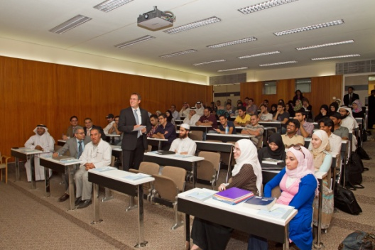
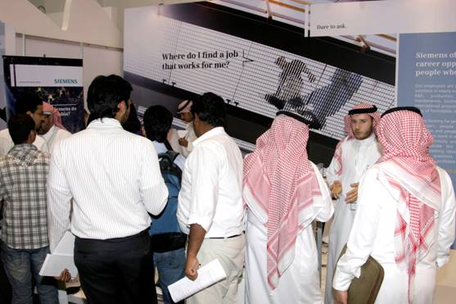














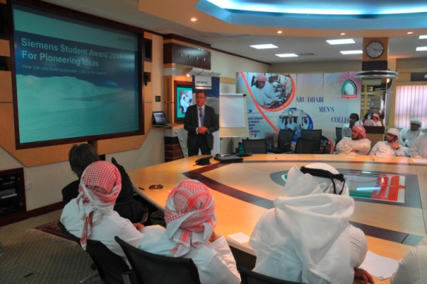

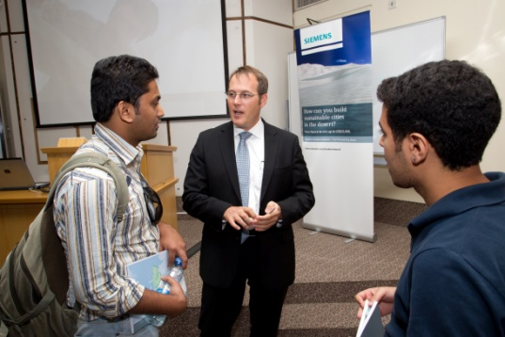

Siemens Student Award 2013
University Engagement
Syria
Iraq
Jordan
Pakistan
Lebanon
KSA
Egypt
Kuwait
Libya
Bahrain
Yemen
Qatar
Iran
UAE
Afghanistan
Oman

Slide 12
Siemens Student Award 2013
Q&A
Siemens ME. All rights reserved.

Slide 13
Siemens Student Award 2013
Thank you and good luck!
Siemens ME. All rights reserved.

