Slide 1
بِسْمِ اللہِ الرَّحْمٰنِ الرَّحِیمِ
Welcome . . .

Slide 2
NETWORK CONNECTIVITY
CONCEPTS, ISSUES,
INVESTIGATION and TROUBLESHOOTING.
A TRAINING FOR MUET IT STAFF
Designed By:
TEAM ICPC

Slide 3
Target Audience
Senior IT Assistants / IT Assistants
LAN / IT Technicians
Clerk-Cum-PC Operators
Individuals having IT Knowledge

Slide 4
AGENDA
Training Theme
An Introduction to ICP Center and its Services
Job Responsibilities of an IT Assistant
Basic Network Concepts.
Common IT issues & Complains at MUET
Configuration of Desktop / Laptop for Internet Connectivity
Assigning IP Address in Windows XP & Windows 7
Some Common Errors Notifications
Verifying/Troubleshooting Network Connectivity
Precautions before panic
Questions

Slide 5
Theme
To Enhance the Skills of IT Personnel at MUET.
Polish the skills of I.T Workforce of MUET, to enable them investigate and Troubleshoot the network connectivity in case of any issue.
To ensure the smooth and uninterrupted network/voice services, by engaging the I.T staff and getting best out of them.

Slide 6
Introduction TO ICPC
The Information Communication & Processing Center is the HUB of various IT Services to MUET
  Primarily ICPC provides Data & Voice Services in order to facilitate the interdepartmental communication with 1000+ Data points and 500+ voice points
  All the departments are physically connected with ICPC backbone via fiber optical cable, providing Gigabit Ethernet speed.
  New Admin Block;
  All the institutes, departments & directorates
  All the hostels.
  For local voice services around campus ICPC uses latest EPABX.
  Along with this ICPC has also deployed Wireless Internet connectivity within or outside of various departments.

Slide 7
I.T Assistants; WHAT DO THEY DO ?
Provide user level technical support for end-users, computers, printers, etc.
Provide user level training on daily applications used, including, MS Word, MS Excel, MS Outlook, MS Publisher, Adobe Acrobat, and other basic cocepts.
Assist with network connectivity and services, Troubleshoot end user hardware and software issues
Perform installations, repairs, and preventative maintenance on staff computers, repairing equipment and providing daily support for computer network users.

Slide 8
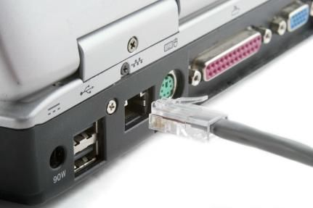
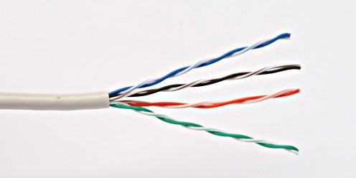
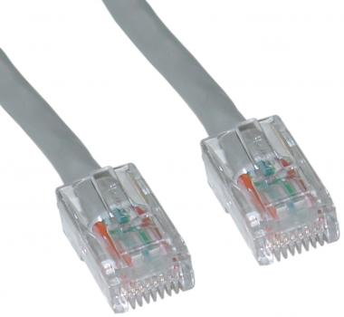
Network Basics. . .
IP /Subnet Mask
Default Gateway
PING
DNS
NSLOOKUP

Slide 9
Common IT issues & Complains at MUET
No Internet access
(Reasons: There are so many reasons) e.g.:
  Incorrect or Duplicate IP Address
  Wrong Default Gateway or Subnet mask
  Misspelled website names, blocked content opening
  Internet inaccessible overall the campus due to fault in Uplink
Faulty Media
  Broken RJ-45 Connector & Base I/O
  Ethernet Cable Malfunctioned
  Faulty LAN Card
Connected but No Browsing
  Wrong DNS IP

Slide 10
Configuration of Desktop/Laptop for Internet Connectivity
Assigning IP Address in Windows 7 & Windows XP

Slide 11
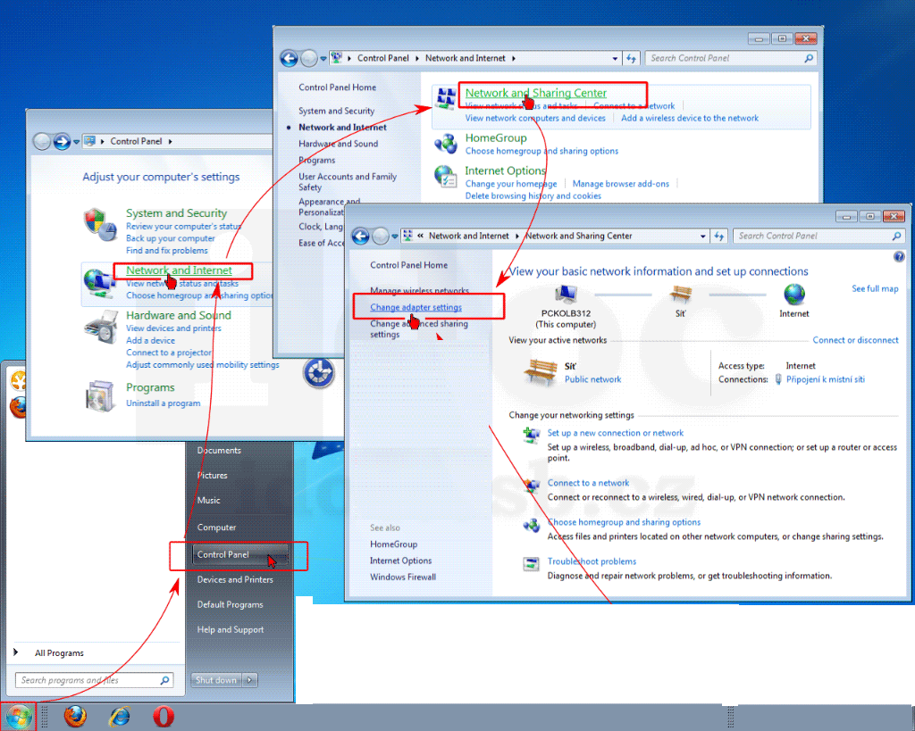
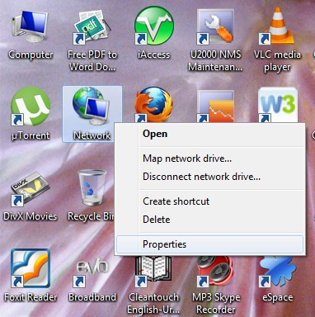
Assigning IP Address in Windows 7
OR

Slide 12
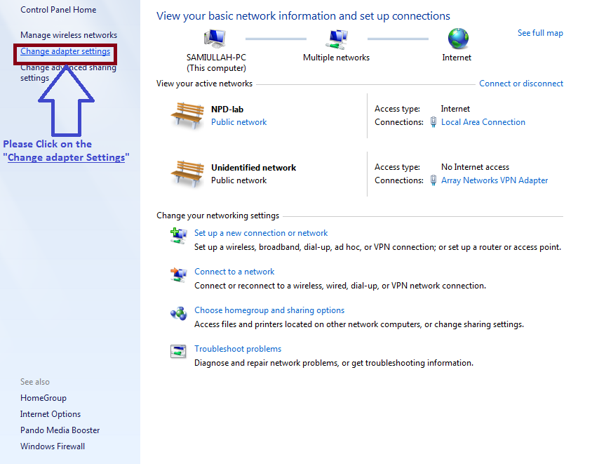
Press “Change Adapter Settings”

Slide 13
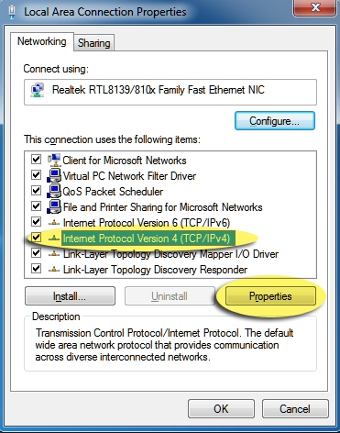
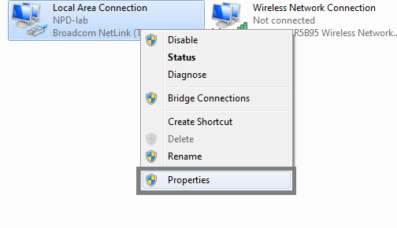
Right Click on “LAN” then “Properties” & “Check TCP/IPV4”
01
02

Slide 14
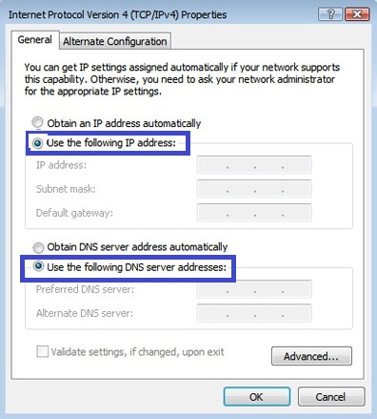
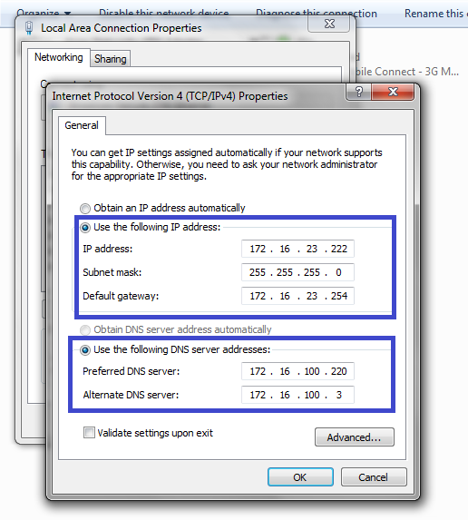
Select “use the following IP” & Fill: IP Address/Subnet Mask/ Default Gateway & Provided DNSes
01
02

Slide 15
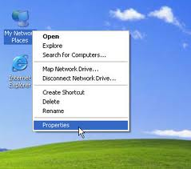
Assigning IP Address in Windows XP

Slide 16
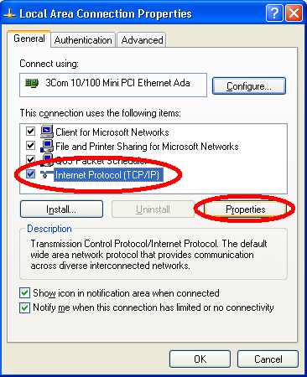
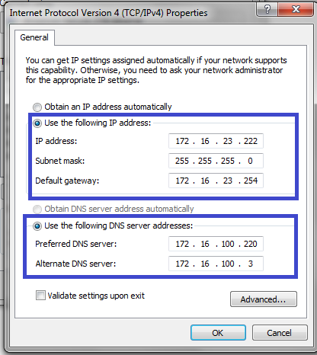
Click on “TCP/IP”, “properties” & Assign Provided IP Address

Slide 17
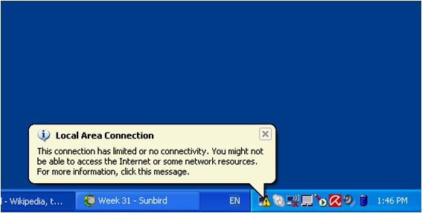
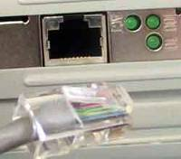
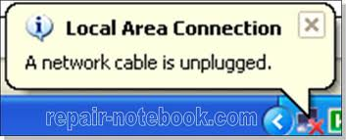

Most Common Errors Notifications
01
The YELLOW Triangle ICON is usually shown:
TCP/IP Settings misconfigured or not configured.
E.g. WRONG DNS, WRONG SUBNET/VLAN etc.
02

Slide 18
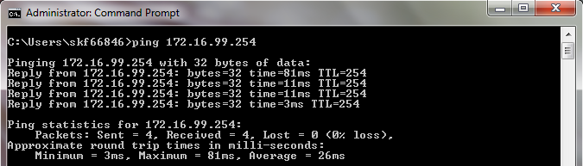
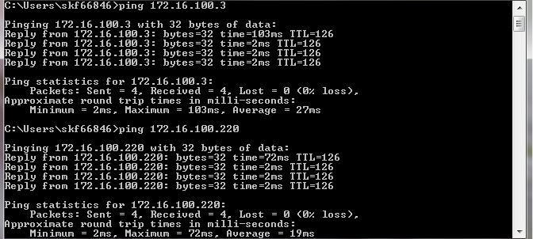
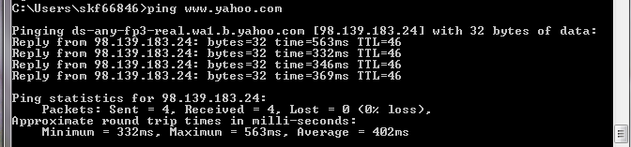
Verifying/Troubleshooting Network Connectivity
PING DEFAULT GATEWAY:
>ping 172.16.99.254
PING DNS1 & DNS2 IP:
>ping 172.16.100.220
>ping 172.16.100.3
PING A website:
>ping www.yahoo.com

Slide 19
PRECAUTIONS BEFORE PANIC
THIS CHECKLIST SHOULD ALWAYS BE VERIFIED BEFORE RAISING ANY COMPLAIN
CHECK IF THE NETWORK CABLE IS PLUGGED IN THE LAN CARD/SWITCH/BASE I/O
IF THE CABLE IS PLUGGED BUT NO INTERNET ACCESS PLEASE CHECK IF THE SWITCH IS ON OR NOT
IF THE SWITCH IS ON BUT INTERNET IS NOT WORKING PLEASE CHECK YOUR TCP/IP SETTINGS AND IP ADDRESSES, DNS SERVER, DEFAULT GATEWAY ARE CORRECT
IF ALL IS CORRECTLY CONFIGURED, PLEASE PING YOUR DEFAULT GATEWAY
IF DEFAULT GATEWAY PING FAILS CONTACT THE ICPC TO CHECK IF IT IS CORRECLTY CONFIGURED
ALSO CHECK THE NEIGHBOR PCS IF THE SAME SITUATION FOUND PLEASE INFORM ICPC STAFF AT: (2095 FOR LOWER DEPARTMENTS; 6028 FOR UPPER DEPARTMENTS)
IF GATEWAY PING IS SUCCESSFUL, THEN PING DNS SERVERS (172.16.100.220 & 172.16.100.3) IF PING SUCCEDS BUT NO BROWSING CHECK YOUR TCP/IP SETTINGS AND CORRECT YOUR DNS SERVERS WITH ABOVE IP ADDRESSES
IF NOTHING WORKS ANY OF THE ABOVE MENTIONED THINGS PLEASE INFORM ICPC TEAM(S)

Slide 20
After training you should be able to do
Understand the fundamental Concepts of Networks, and nature of basis network connectivity problems.
How to display and investigate if IP ADDRESS SETTINGS are correct, How to correct them if they’re not
Checking connectivity with the network and default gateway
Checking Connectivity with the Internet from CMD
To coordinate with the right technical person of ICPC for any complex situation EXT: 2094

Slide 21

Thank you. . .

